Slide 1
Project Progress

Slide 2
Team Members
Khushi Jani
Aasritha Devi Surapaneni
Pavan Kalyan Imadabathini

Slide 3
Project Title
Climate Change Impact Simulator

Slide 4
Project Description
The Climate Change Impact Simulator is a project designed to use the extensive "Climate Change: Earth Surface Temperature Data" from Berkeley Earth, integrating it with advanced climate models to simulate the effects of climate change on different regions
The project aims to develop an interactive website where users can visualize the potential impacts of climate change based on historical data and future projections
Leveraging the power of AWS for computational needs and data storage, the simulator seeks to provide a dynamic, user-friendly platform for understanding and analyzing the regional consequences of evolving climate patterns

Slide 5
Used Datasets, links to sources
Dataset

Slide 6
Data Collection and Cleaning
Load Data: It reads five different temperature datasets into pandas Data Frames.
Initial Analysis: It calculates and prints the number of missing values in each data frame and their dimensions
Clean Data: Drops all rows with missing values from the df_city Data Frame
Post-cleaning Analysis: It reassesses and prints the count of missing values in each Data Frame to ensure that all missing data has been addressed
Save Cleaned Data: The cleaned DataFrames are then saved back to CSV files for future use

Slide 7
Data Visualization

Slide 8
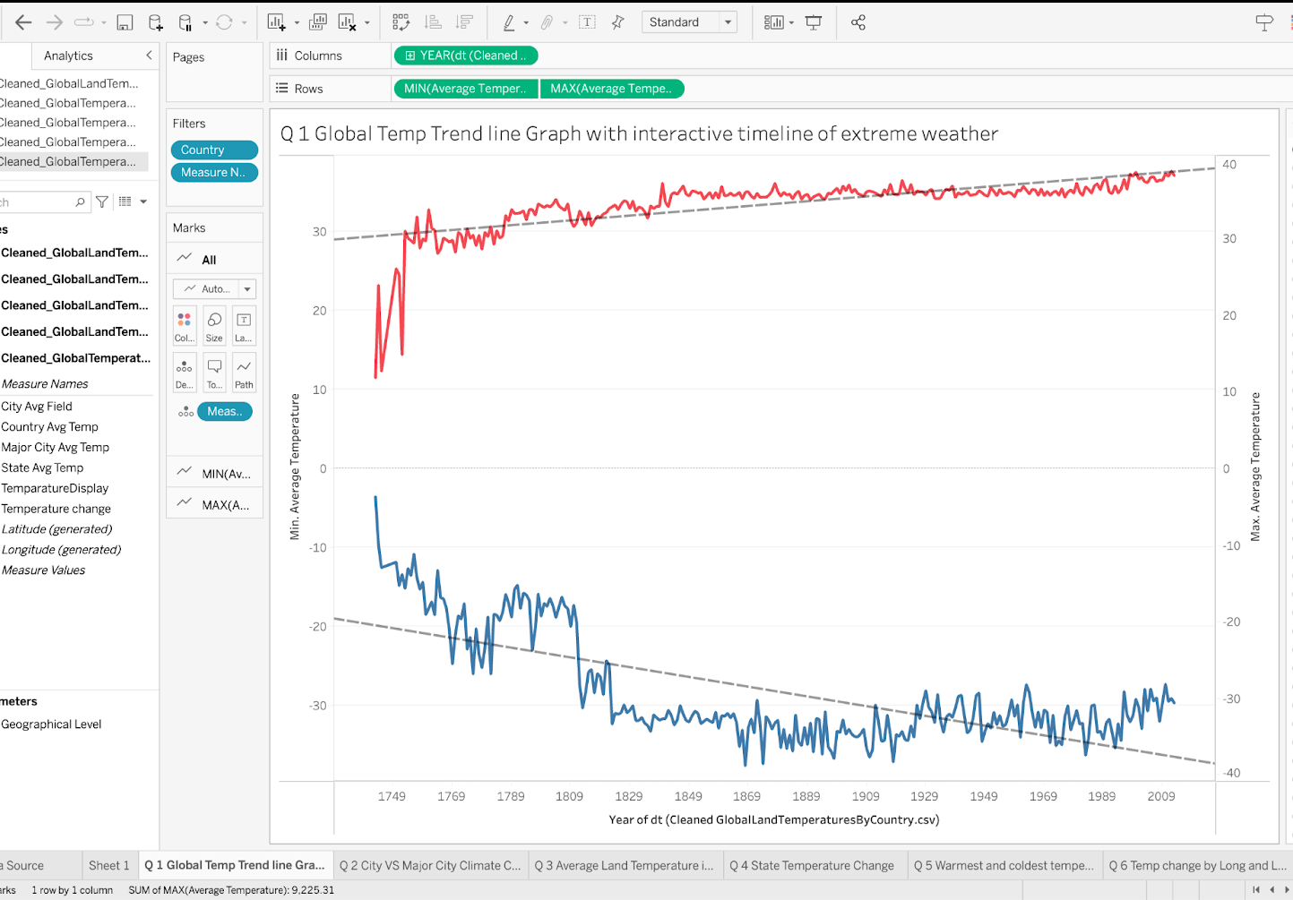
Global Temp Trend Line Graph with interactive timeline of extreme weather
This visualization presents a historical view of global temperature trends, contrasting maximum and minimum average temperatures over several centuries
The upper graph's red line indicates periods of particularly high temperatures, while the lower graph's blue line suggests a general decrease in minimum average temperatures over time
Such data is crucial for understanding long-term climate change and its impacts across different geographies

Slide 9
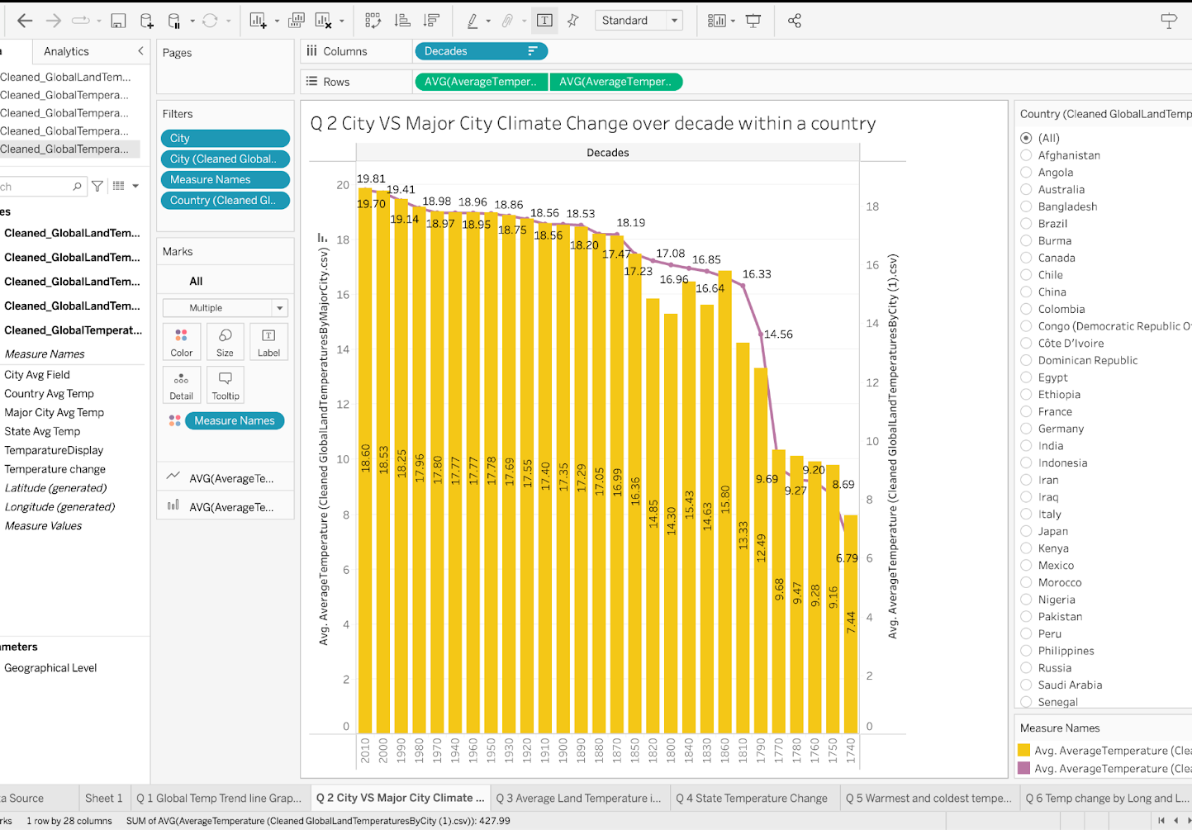
City VS Major City Climate Change over a decade within a country
This visualization shows a bar chart comparing the average temperature changes over several decades within a country, distinguishing between a specific city and major cities as a whole
The yellow bars represent the average temperature for each decade for a city, and the purple line possibly represents the temperature trend for major cities in the same country
This could suggest a cooling trend in the major cities' average temperatures over time, although the reason for this trend is not explained in the visualization

Slide 10
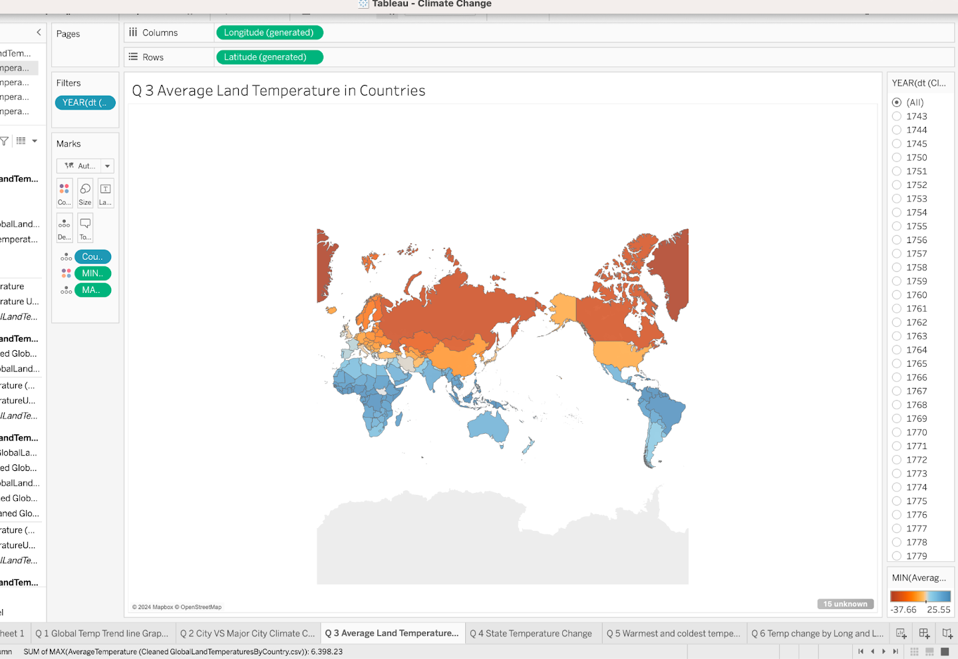
Average Land Temperature in Countries
This visualization is a choropleth map depicting average land temperatures across different countries
The map uses a color gradient to indicate temperature ranges, with cooler temperatures likely represented by blues and warmer temperatures by reds and oranges
This kind of visualization is useful for identifying global patterns in climate data and for making comparisons between countries' average temperatures for selected years

Slide 11
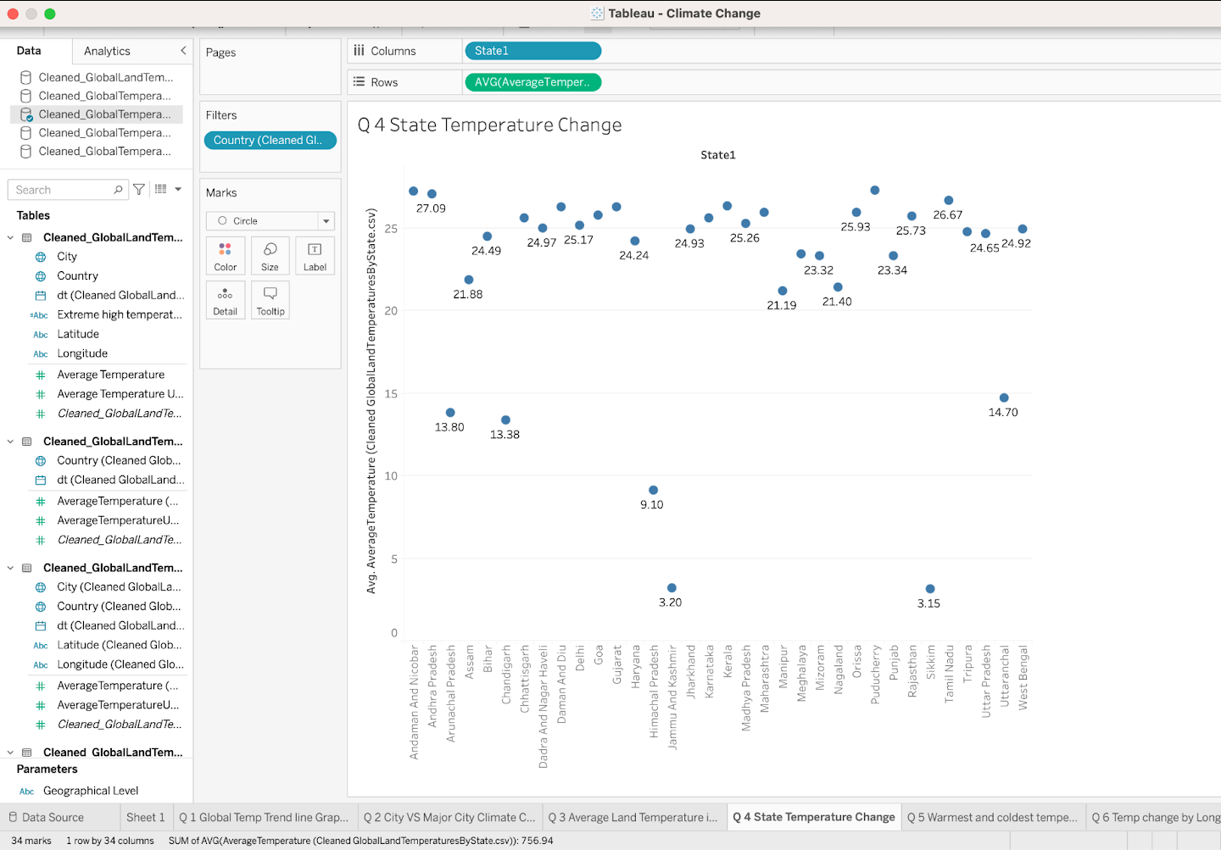
State Temperature Change
This visualization displays a scatter plot representing the change in average temperature by state within a country
Each dot represents a state, plotted along the x-axis, which shows various states labeled 'State1', and the y-axis, indicating the average temperature change in Celsius
This scatter plot allows for a quick comparison of temperature changes across states, identifying which ones have experienced more significant changes

Slide 12
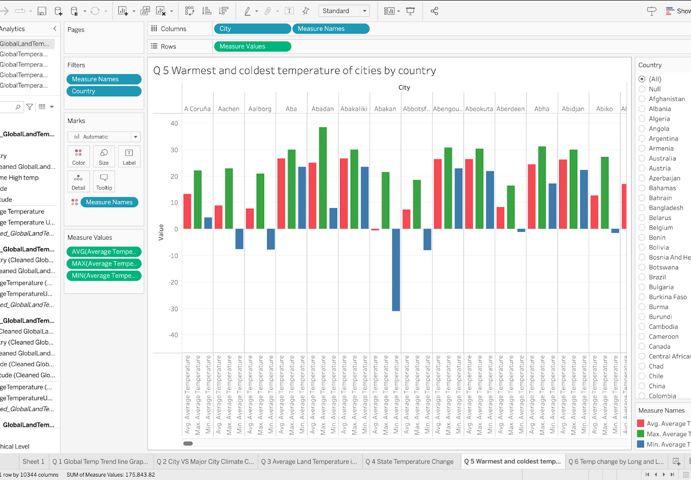
Warmest and coldest temperature of cities by country
This visualization is a clustered bar chart showing the warmest and coldest average temperatures recorded in various cities, sorted by country
Each city is represented by a group of three bars indicating the average, maximum, and minimum temperatures
This allows for a quick visual comparison of temperature ranges within cities and identifies which cities experience the greatest temperature extremes

Slide 13
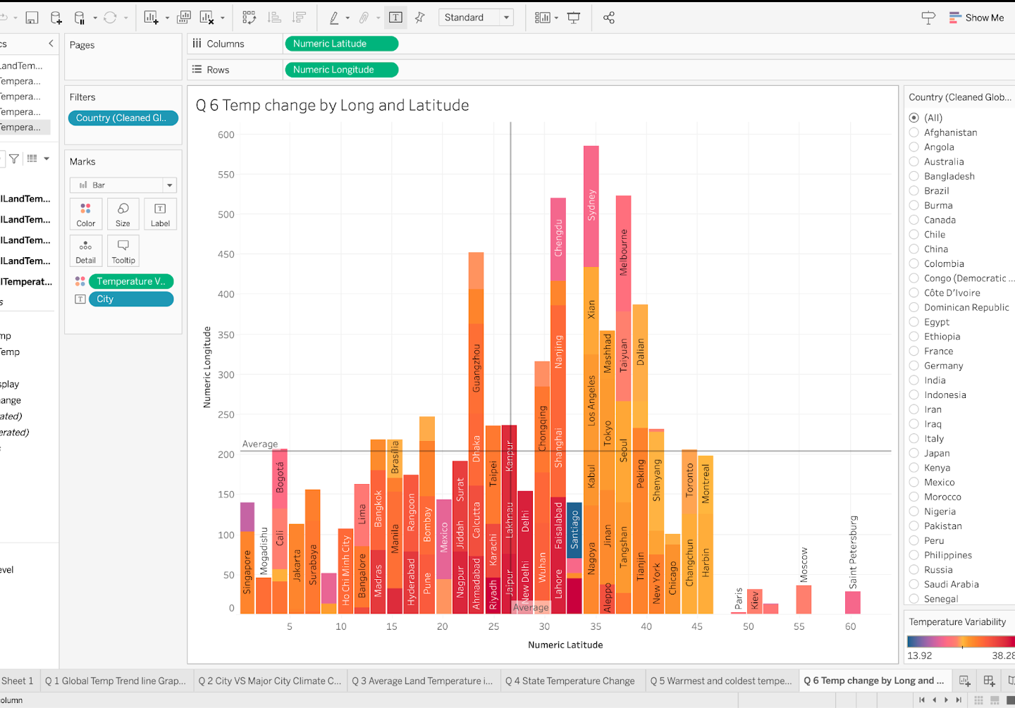
Temp change by Long and Latitude
This visualization is a 3D bar chart that appears to represent temperature changes in various cities, plotted against their numeric latitude and longitude coordinates
The bars are color-coded and likely correspond to different ranges of temperature variability or changes
This type of chart can help visualize spatial patterns in temperature change, showing how different locations around the world are affected by climate factors

Slide 14
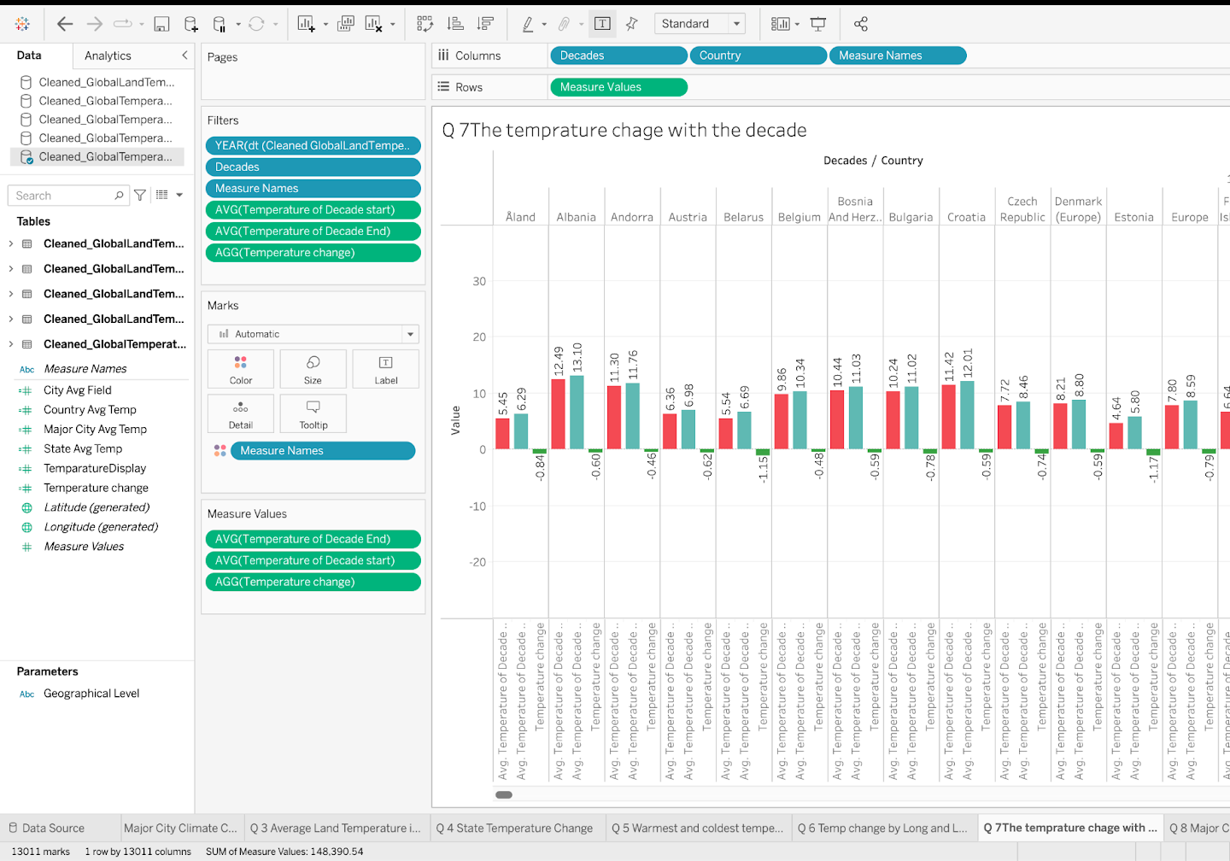
The temperature change with the decade
This visualization is a bar chart that shows the temperature change by decade for various countries
Each country has two bars: one representing the average temperature at the start of a decade and the other representing the average temperature at the end of the decade
This type of chart helps to compare the rate and direction of temperature changes across different countries over each decade

Slide 15
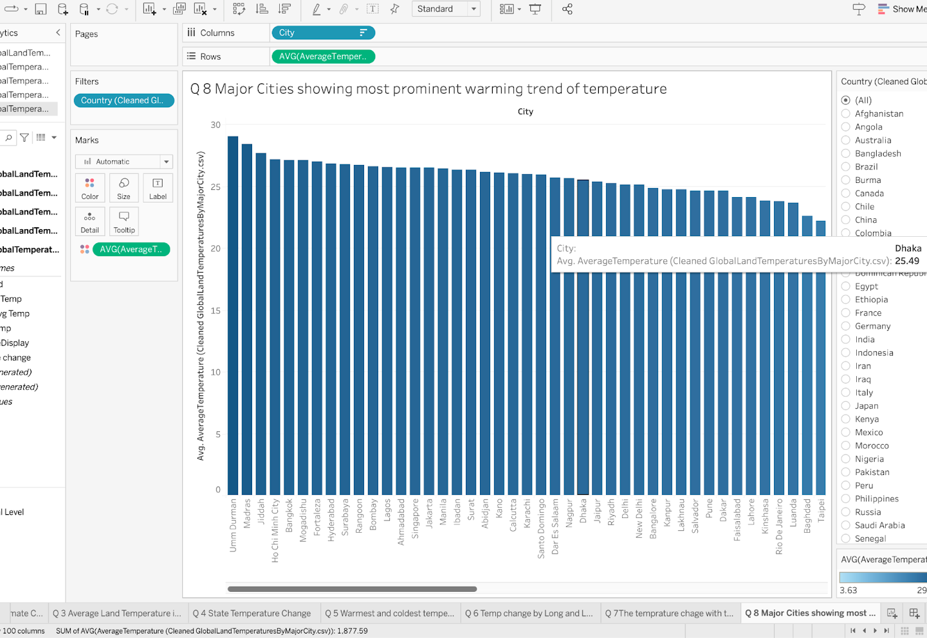
Major Cities show the most prominent warming trend in temperature
This visualization is a horizontal bar chart showing the average temperature of major cities, arranged to highlight those with the most prominent warming trends
This chart makes it easy to identify which cities have higher average temperatures, possibly indicative of urban heat islands or regions with higher warming trends
The ability to filter by country, seen on the right, allows for a more focused analysis of temperature trends within specific nations

Slide 16
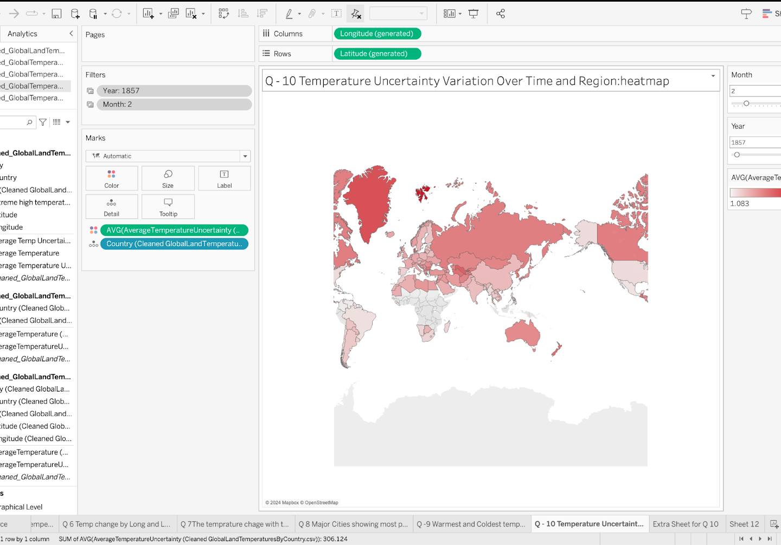
Temperature Uncertainty Variation Over Time and Region: heatmap
This visualization is a global heatmap displaying temperature uncertainty variation across different regions over time
This tool could be particularly useful for climate scientists or researchers interested in the reliability of temperature data and its spatial and temporal variance
It seems to allow users to select specific years and months to examine uncertainty in temperature measurements or predictions for those periods

